Slide 1
ECE 441
Monitor Project

Slide 2
Outline
Introduction
Command Interpreter
Debugger Commands
Exception Handlers
User Instruction Manual
Guidelines and Helpful Hints
Project Report Template
Project Demonstration in SANPER

Slide 3
Introduction
The goal of the project is to build up a monitor program.
The monitor should be able to perform basic debugger functions, such as memory display, memory sort, memory change, block fill, block search, block move and also, it can deal with exceptions.

Slide 4
Introduction
Entire code must be smaller than 3K size starting from $1000 (including look-up tables for help and error messages).
1 K stack size residing in memory locations $3000 and up
Include any relevant I/O trap #14 routines in code
Erroneous inputs should not kill program but the number of errors statements should be minimum.

Slide 5
Command Interpreter
The monitor recognizes which command is entered and then branches to subroutine for executing this command. And when there is no match, it displays error message.
COMP_TABL is a pointer on the command names.
COMP_ADDR is a pointer on the addresses of the subroutines.
INPUT is a buffer where the input command with the arguments is stored.

Slide 6
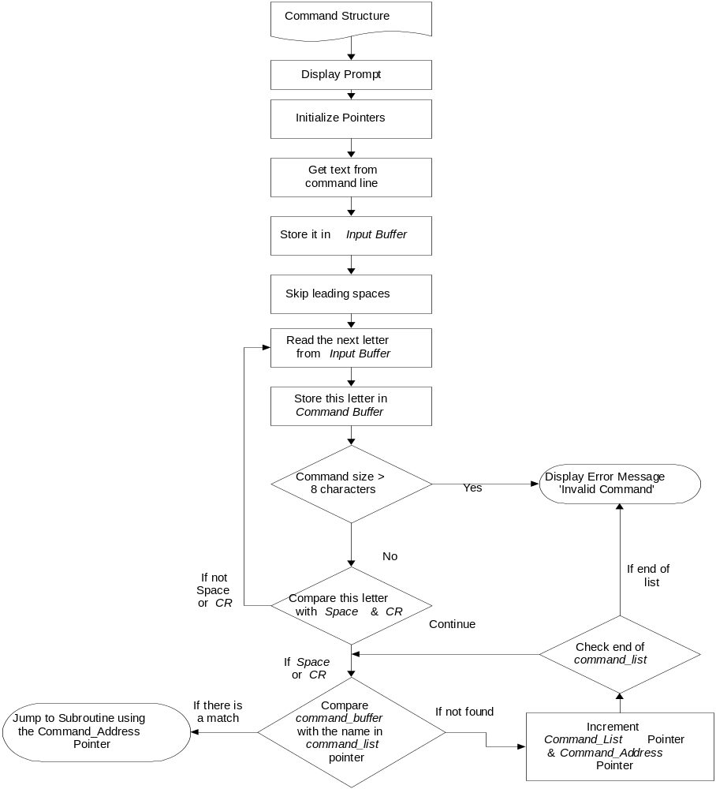
Command Interpreter Flowchart

Slide 7
Debugger Commands
In the debugger commands part, you must define appropriate commands (at least 12 commands for the full monitor program implementation) and provide adequate descriptions for including these commands. You must also describe the basis for your selection of the commands and provide minimum three references for the monitor program.
The monitor must be able to execute your selection of commands after prompt “MONITOR441>” and terminated with carriage return, <CR>. The group of commands must deal with a basic breakpoint mechanism support and memory operations including memory display, modify, move, search and memory testing.

Slide 8
Debugger Commands
There will be at least 12 Debugger Commands
Look for Tutor user guide for more information
Each command should have algorithm and/or flowchart.

Slide 9
Example (MDSP)
Memory Display
The MDSP (Memory Display) command outputs the address and memory contents from address 1 to address 2 in the syntax given below:
MONITOR441> MDSP <address1> <address2>
Example…..
MONITOR441>MDSP $908 $90A <CR>
908 06
909 FF
90A C2

Slide 10
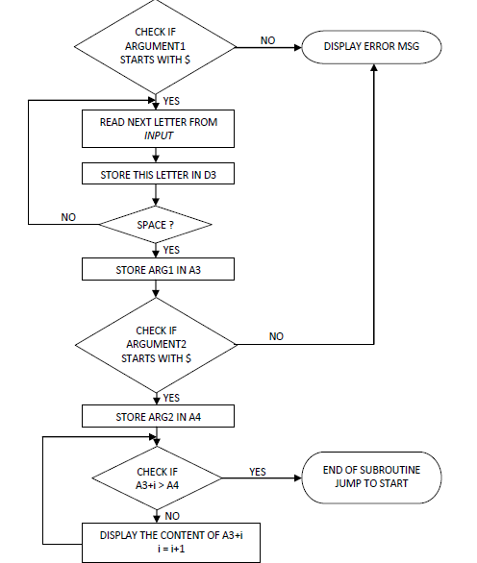
Example (MDSP)
Memory Display

Slide 11
Exception Handlers
In the exception handler part, the monitor must be able to handle the different system exceptions of MC68000. (Use experiment 3 as reference)
Bus Error Exception : This exception handler should also display the contents of Supervisor Status Word, Bus Address and Instruction register all in a single line with spaces in between them
Address Error Exception : This exception handler should also display the contents of Supervisor Status Word, Bus Address and Instruction register all in a single line with spaces in between them
Illegal Instruction Exception
Privilege Violation Exception
Divide by Zero Exception
Line A and Line F Emulators

Slide 12
Exception Handlers
In order to handle exception we have modified the exception vector table:
MOVE.L #BUS_ERR,$8
MOVE.L #ADS_ERR,$C
MOVE.L #IL_INST,$10
MOVE.L #DIV_Z,$14
MOVE.L #PRI_VIO,$20
MOVE.L #LINE_A,$28
MOVE.L #LINE_F,$2C

Slide 13
Exception Handlers
For each exception we need to display the value of the registers, so we store all the registers in the stack starting at address $3000
Then we display all the registers, we restore the values and we jump back to our monitor program.
For the bus error and address error routines, we need also to display the content of the Supervisor Status Word, Bus Address and Instruction register all in a single line with spaces between them. This is done by reading the content of A7.

Slide 14

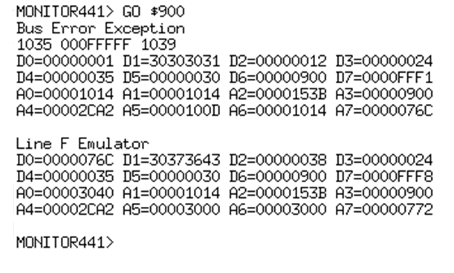
Exception Handlers

Slide 15
User Instruction Manual
In the instruction manual part, the monitor program should include a help screen for every command and their syntax such as the required parameters and operands

Slide 16
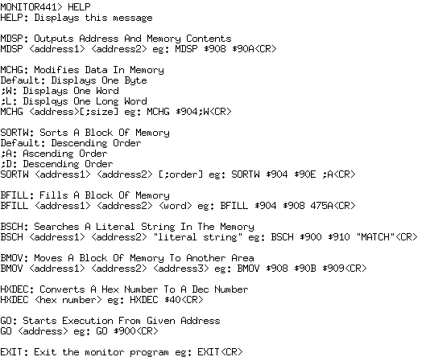
User Instruction Manual

Slide 17
Guidelines and Helpful Hints
First step in the monitor program is to initialize the system constants.
Assign memory addresses to STACK,
Example:
STACK EQU $XXXXXX
.
.
.
Initialize all necessary look up tables required. For e.g.: Breakpoint address table which stores up to eight breakpoint addresses

Slide 18
Guidelines and Helpful Hints
Create the Command Table: Each command should take two long-word size memory spaces and end with 'space' character. This will mark the end of the command.
First part in the table is the command names, second part is the command addresses.
ORG $XXXX
COM_TABL DC.B 'HELP ',0
DC.B ‘MDSP ’,0
DC.B 'MTST ',0
COM_ADDR DC.W HELP;HELP is the address for HELP command subroutine
DC.W MDSP
DC.W MTST
.
.
ORG $XXXX
HELP Put your code here
Return to your monitor program
MDSP Put your code here
Return to your monitor program
IMMTST Put your code here
Return to your monitor program

Slide 19
Guidelines and Helpful Hints
Second step is to setup exception vector table. You will develop your own exception handler routines for most of these exceptions.
ORG $XXXX
MOVE.L #STACK, $0
MOVE.L #BUS_ERR, $8
MOVE.L #ADRS_ERR, $C
MOVE.L #ILL_INST, $10
MOVE.L #DIV_ZERO, $14
MOVE.L #PRIV_VIOL, $20
MOVE.L #TRACE, $24
MOVE.L #LINE_A, $28
MOVE.L #LINE_F, $2C

Slide 20
Guidelines and Helpful Hints
Third step is to write the code for the Command Interpreter:
Command Interpreter recognizes which command is entered and then branches to subroutine for executing this command. It compares the input for all the commands in the command table and when there is no match, it displays error message:
"Invalid command".
Error check for arguments is done inside the command subroutine.
If there is an error, each command subroutine displays error message:
Note that command subroutines should branch back to the start of monitor program after execution.

Slide 21
Guidelines and Helpful Hints
You may use two pointers for implementing command table:
Command_list pointer points to the command names in ASCII format. These names are used to match the input text.
Command_address pointer points at the actual address of the command subroutines in the table.
While doing a search in the table, all the letters should match and they should end with either 'Space' or 'CR' character. Incomplete command names or redundant letters in the command name are not acceptable and will cause 'Invalid Command' error

Slide 22
Project Report Template

